Slide 1


MEE5105 工程优化基础
Path Planning Problem
Based on Evolutionary Computation
钟慕尧 11849335 吴明远11849319
2019.12.24

Slide 2
CONTENTS
1
Problem Representation
3
Experiments and Results
2
Evolution Computation Framework
4
Discussion

Slide 3

v
v
“
Part I. Problem Representation
”

Slide 4
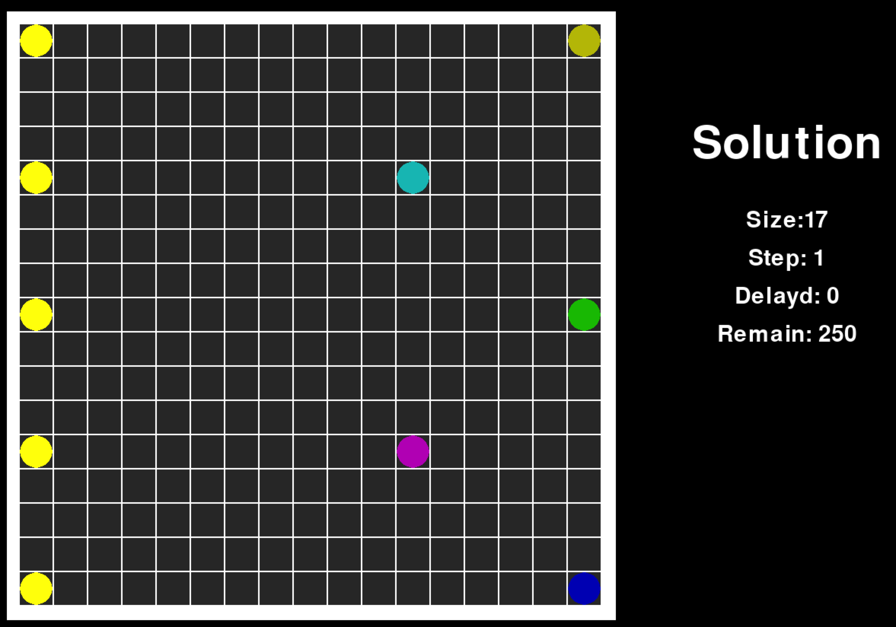
Part I . Problem Representation
Map: a fixed-size checkerboard.
Warehouse: bright yellow dots no the Map.
Destination: other colored dots, each marked with a number (here is 1-5).

Slide 5
Part I . Problem Representation
Goods at each Warehouse: a list, the number represents the destination of the items respectively.
Problem: a matrix consisting of the above lists.
Rules:
Each warehouse can import ONE goods at most in a single step.
Each Destination can only receive ONE goods at a single step.
Every goods on the Map can only choose ONE action from [ Right, Up, Down, Stay] until it arrives at its destination.
Two Goods cannot move into the same place on the Map at the same time.
Of cause, the goods cannot move out of the Map.
[1,2,5,3,2,4,5,2,1,…,3,3,5]
[[1,2,5,3,2,4,5,2,1,…,3,3,5],
[2,3,4,1,5,2,4,2,3,…,4,2,1],
…
…
[1,1,3,2,4,2,3,4,5,…,2,1,3]]
U
S
R
D

Slide 6
Part I . Problem Representation
Single Solution:
In order to get the shortest time to complete the task, obviously, every goods should run in the shortest path.
The steps in the shortest path are actually determined. (If not to consider the Stay step.)
So, the task is to optimizing the order of the steps in the shortest path.
Represented by a step list as:
[D,D,D,D,R,R,R,D,D,D,…,R,R,R]

Slide 7
Part I . Problem Representation
Warehouse Solution:
For each goods in a Warehouse, it has its own path regardless of its order in the goods list.
So, the solution of a Warehouse is a Matrix as:
Not every path in the matrix is of the same length. (Better to call it a Two-dimensional Array)
[[D,D,D,D,R,R,R,D,D,D,…,R,R,R],
[R,D,R,R,D,D,…,D,D,R],
[R,D,R,D,R,R,R,…,D,D,R],
…
…
[U,U,R,R,R,R,U,…,U,U,R]]

Slide 8
Part I . Problem Representation
Overall Solution:
A overall solution consists of the solutions of each Warehouse.
It is a 3-Dimensional Array. As:
[ Warehouse1_solution,
Warehouse2_solution,
Warehouse3_solution,
Warehouse4_solution,
Warehouse5_solution]

Slide 9
Part I . Problem Representation
Analysis:
As the solution representation shows, it has a very large solution space, and it impossible to find the best path for all of the goods.
Traditional search methods may take millions of years to find the solution, however, a Evolutionary Computation method can help to find an acceptable result for a given problem quickly.

Slide 10
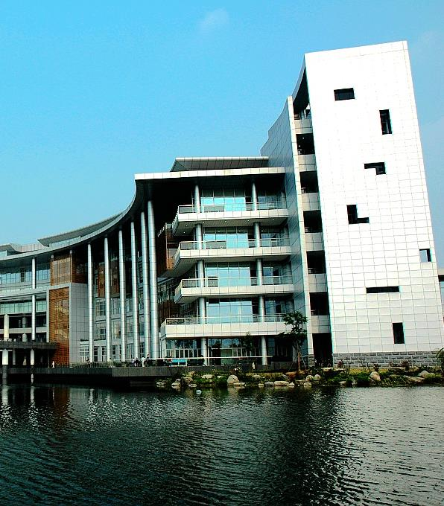
“
Part II. Evolutionary Computation Framework
”

Slide 11
Part II. Evolutionary Computation Framework
Fitness Function
This is the most import part of the Evolutionary Computation , which can evaluate every solution and give a score of the solution.
In this problem, the fitness score is the total time cost in the solution.
But how to get the score of a solution is an other problem:
You get a randomly generated solution , a 3-dimensional array.
There must be a lot of collisions if you run it exactly, and some goods will block the way, and the problem will not be completed.
Collision
Block

Slide 12
Part II. Evolutionary Computation Framework
Fitness Function
Solve Collision:
If there is another action in the rest of the path, choose it and see if it is acceptable.
If yes, then change the order of the two step.
If no, Stay.
Solve Block:
If there is only one kind of actions in the rest of the path, then Lock the rest path, and other goods will not allowed to go into or through the area.
Solve Collision:
Solve Block:
Locked Area

Slide 13
Part II. Evolutionary Computation Framework
Mutation
Delay: Every “Stay” action will be recorded by a matrix, it is obvious that the goods will large delay is not very efficient.
Choose several goods in each Warehouse that have the largest delay number and change it may help improve the solution, that is the Mutation.
Randomly generate a new order of its own Solution.
Mutation:

Slide 14
Part II. Evolutionary Computation Framework
Population
The number of Solutions in the Problem. (10, for example)
Generation
The max iteration in the EC process.(150, for example)
They depends on the computational resource you have.
Generally speaking, the larger the better, but will take longer time and consume more computing power.

Slide 15
Part II. Evolutionary Computation Framework
Crossover
Choose two well performed Overall solution , and make a hybrid of them may help to get a better Solution.
Get the delay Matrix of each solution(A and B), M1 and M2.
Get M=M1-M2, and choose several largest elements in the Matrix, which means the solution in Solution B is better.
Change the single solution in Solution A with the single solution in Solution B respectively.
Get the child Solution.
Solution A (delay 43):
Solution B (delay 12):
Crossover
Solution C (delay ??):

Slide 16
Part II. Evolutionary Computation Framework
Evolution:
Rank all the child solutions and the parents solutions by their fitness scores.
Put the first several solutions into the next evolution loop, and remove the rest of them.
1st Solution_32: fitness 157
2nd Solution_43: fitness 159
3rd Solution_22: fitness 162
…
10th Solution_31: fitness 167
11th Solution_76: fitness 169
…
20th Solution_11: fitness 201

Slide 17

“
Part III. Experiments and Results
”
Page 17
Research,Innovation and Entrepreneurship

Slide 18
Part III. Experiments and Results
Problem:
Broad size: 17x17
Warehouse number: 5
Destination number: 5
Goods number : 50 (in each warehouse)
Super Parameters:
Population: 10
Generation: 150

Slide 19
Part III. Experiments and Results
Theoretically optimal solution:
The longest path in the problem is 17+17=34, and the last goods will get into the map in the 50th step.
Fitness*=34+50=84
But, it almost impossible to find that solution. (May not exist)
Acceptable Solution:
Maybe 34+50*2=134 is a acceptable solution, any way.

Slide 20
Part III. Experiments and Results
Result:
The fitness of the initial Solutions: [155, 158, 167, 168, 173, 182, 183, 184, 185, 191]
After several generations:
Initial : [155, 158, 167, 168, 173, 182, 183, 184, 185, 191]
In 1 generation: [150, 150, 152, 153, 153, 154, 155, 161, 162, 162]
In 2 generation: [143, 147, 150, 150, 152, 152, 153, 153, 154, 155]
In 3 generation: [143, 147, 150, 150, 152, 152, 152, 152, 153, 153]
In 4 generation: [143, 147, 150, 150, 152, 152, 152, 152, 153, 153]
In 5 generation: [143, 147, 150, 150, 152, 152, 152, 152, 152, 153]
In 6 generation: [143, 145, 147, 147, 148, 148, 150, 150, 152, 152]
In 7 generation: [143, 145, 147, 147, 148, 148, 150, 150, 150, 152]
…

Slide 21
Part III. Experiments and Results
In 29 generation: [142, 142, 145, 146, 147, 147, 147, 147, 147, 148]
In 30 generation: [140, 142, 142, 145, 146, 147, 147, 147, 147, 147]
…
In 38 generation: [140, 142, 142, 142, 144, 145, 146, 147, 147, 147]
In 39 generation: [139, 140, 141, 142, 142, 142, 143, 143, 143, 145]
…
In 98 generation: [133, 139, 140, 140, 141, 141, 142, 142, 142, 142]
In 99 generation: [133, 139, 139, 140, 140, 141, 141, 142, 142, 142]
…
In 111 generation: [133, 139, 139, 139, 140, 140, 141, 141, 141, 142]
In 112 generation: [132, 133, 139, 139, 139, 140, 140, 141, 141, 141]
…
In 148 generation: [132, 133, 139, 139, 139, 140, 140, 141, 141, 141]
In 149 generation: [132, 133, 139, 139, 139, 140, 140, 141, 141, 141]

Slide 22
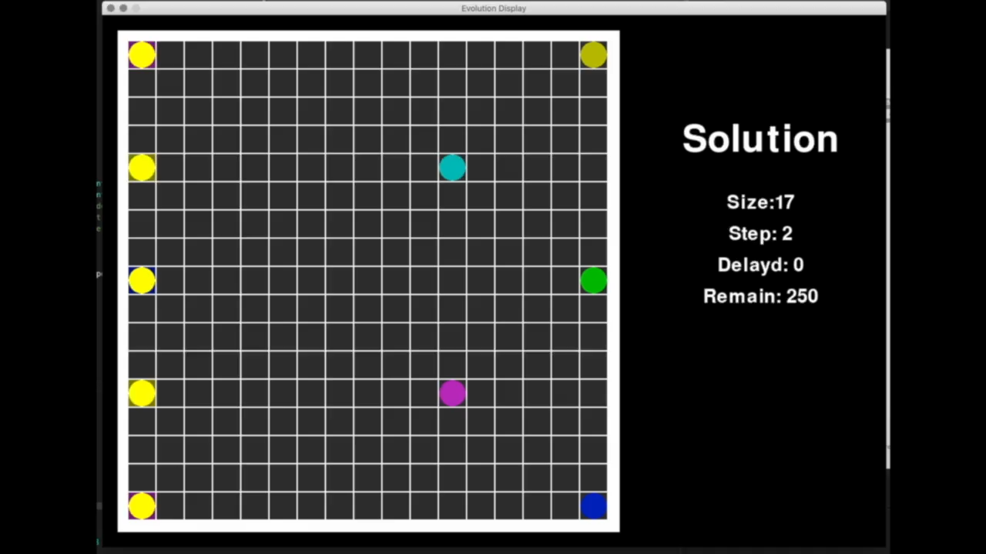
Part III. Experiments and Results
Visualization of the best solution found:

Slide 23

“
Part IV: Discussion
”
Page 23
Research ,Innovation and Entrepreneurship

Slide 24
Part IV. Discussion
Hypothesis:
According to the result, the image of this function Fitness(solution) might look like this:
It is not hard to find a solution that is acceptable.
And the optimal solution is not easy to get, while the suboptimal solution is easy to find.
Also, the optimal solution is not much better than suboptimal solution.

Slide 25
Part IV. Discussion
https://github.com/mythezone/simple_shiping_problem

Slide 26

THANK YOU

